Slide 1

SQL DATA TYPES
Docente: Dott. Daniele Gobbo Modulo 3

Slide 2
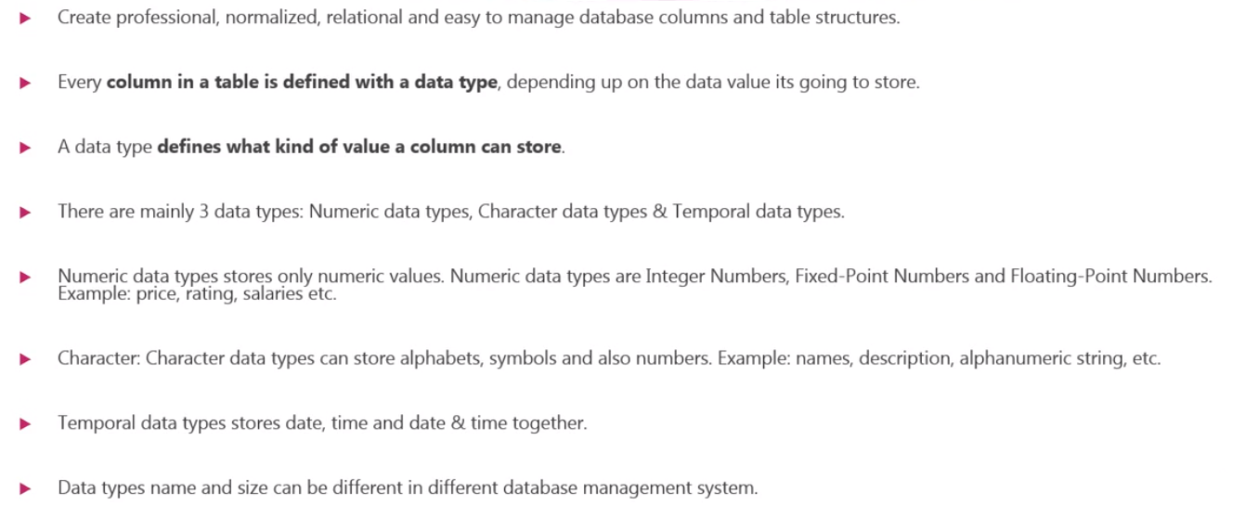
WHAT IS DATA TYPE IN SQL?

Slide 3
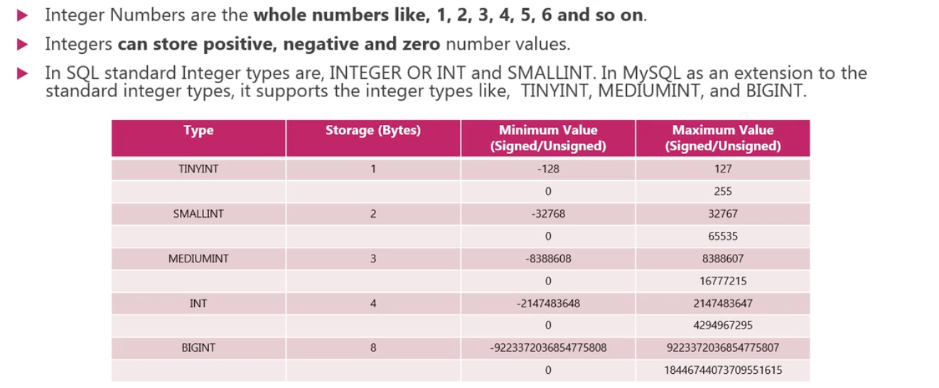
INTEGER NUMBERS (EXACT VALUE)

Slide 4
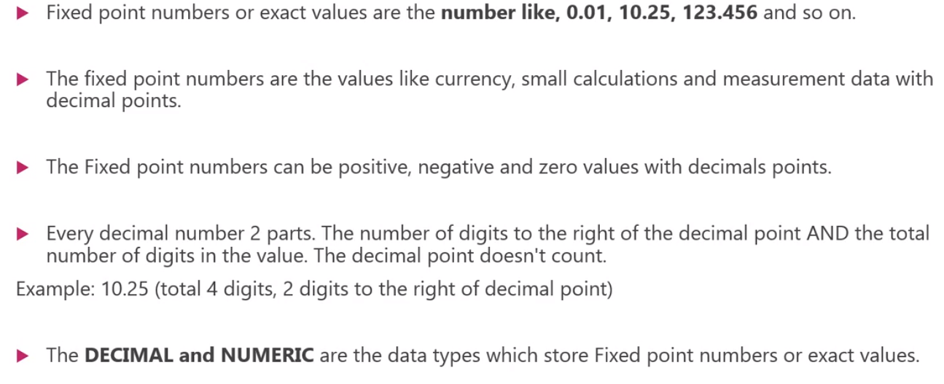
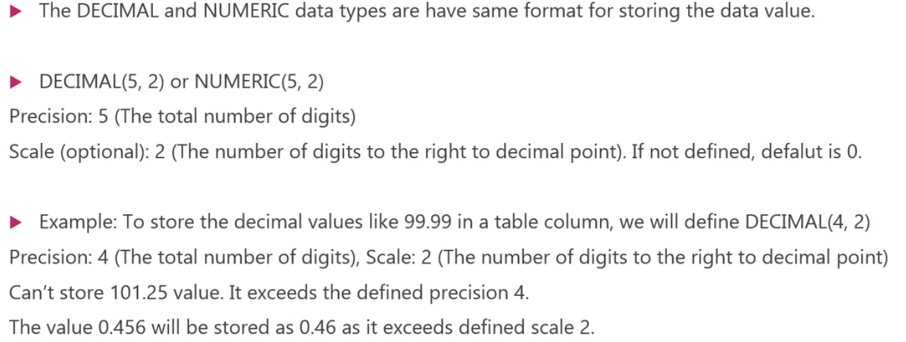
FIXED-POINT NUMBERS (EXACT VALUE)

Slide 5
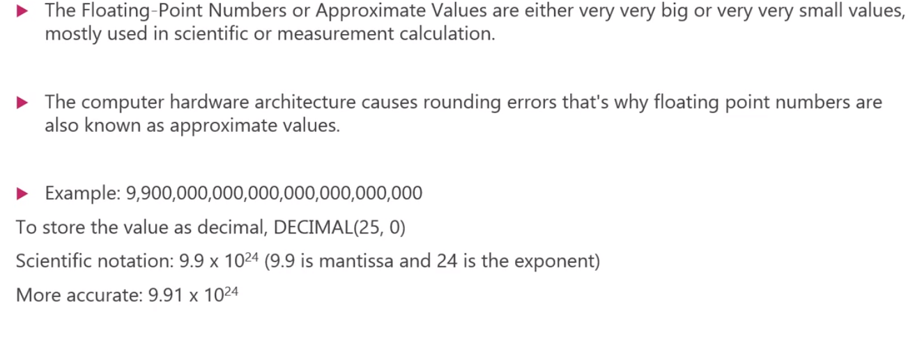
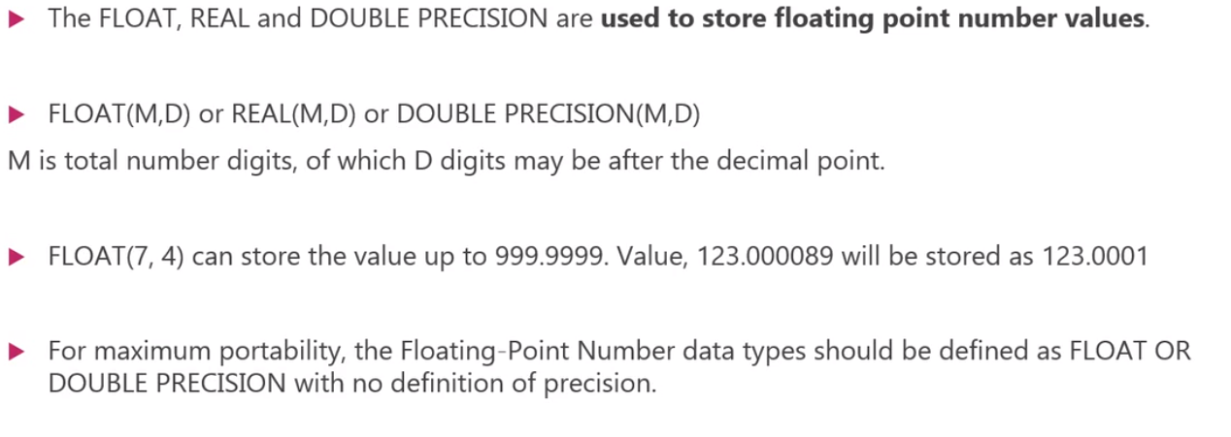
FLOATING POINT NUMBERS (APPROXIMATE VALUE)

Slide 6
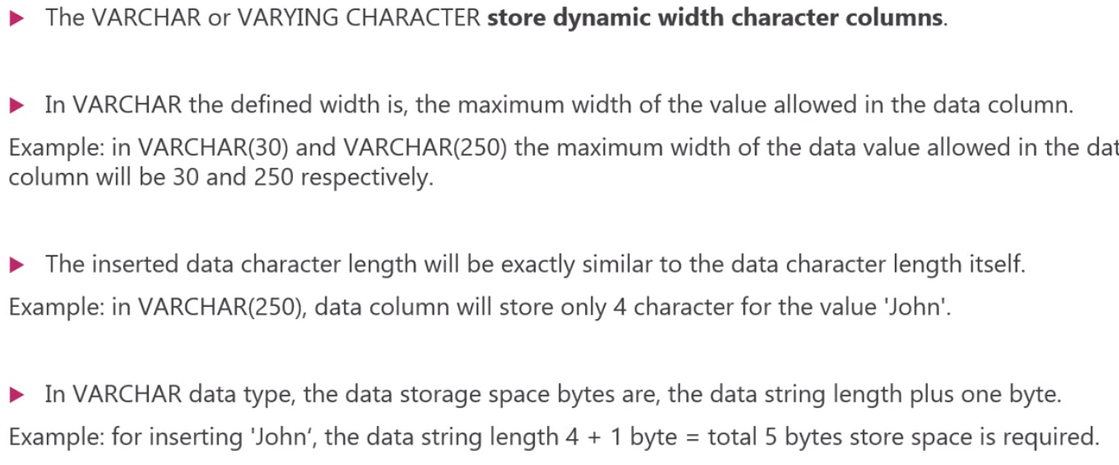
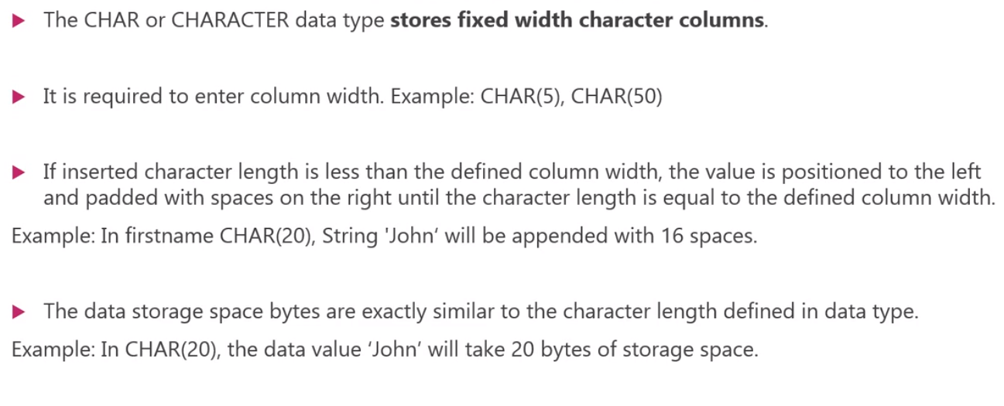
CHAR AND VARCHAR (STRING)

Slide 7
CHAR AND VARCHAR (STRING)
CREATE TABLE char_data_types (
char_column char(10),
varchar_column varchar(10),
text_column text );
INSERT INTO char_data_types VALUES ('abc', 'abc', 'abc'), ('defghi', 'defghi', 'defghi’);
COPY char_data_types TO 'C:\typetest.txt'
WITH (FORMAT CSV, HEADER, DELIMITER '|');

Slide 8
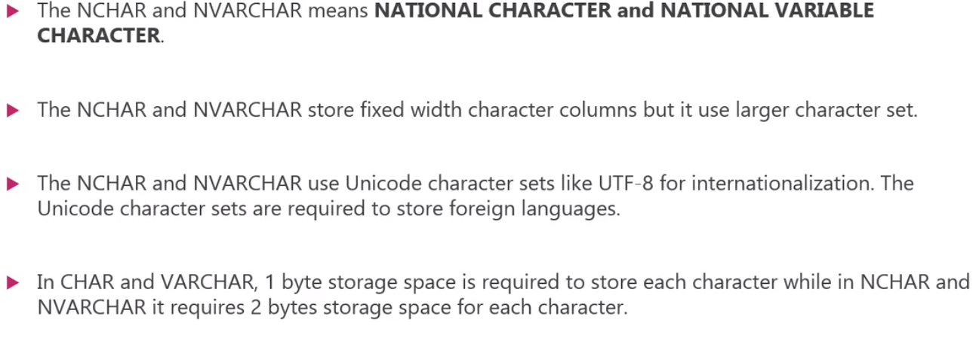
NCHAR AND NVARCHAR (STRING)

Slide 9
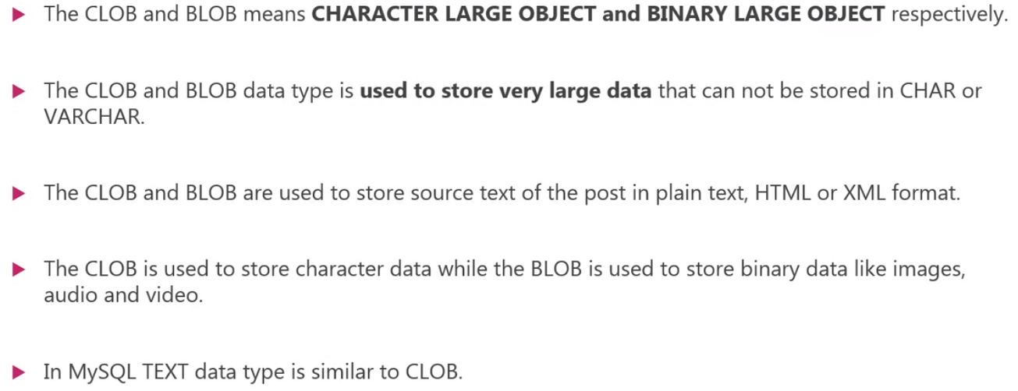
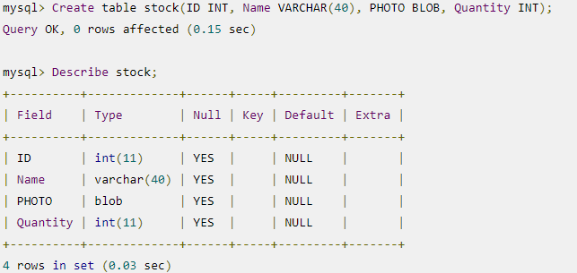
CLOB and BLOB(STRING)

Slide 10
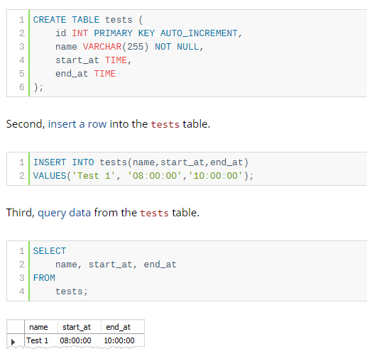
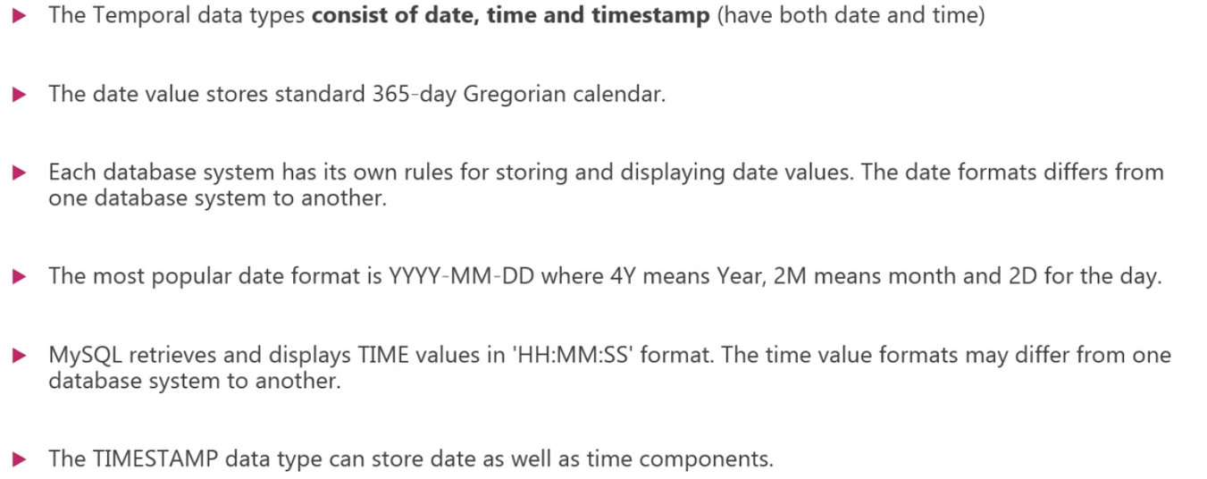
DATE,TIME and TIMESTAMP(STRING)

